Slide 1

Ensemble learning Stacking Linear Regression
Nestor V. Queipo
nqueipo@berkeley.edu https://github.com/nqueipo/theRICEvisit
Houston, June 17th 2019
Notes:
Thank you for coming!; my name is Nestor. I would like to share the rationale for selecting this particular topic. 1. Why Ensemble learning? It is not only a fundamental topic in statistical learning but it is a methapor for what you are building here. The ensemble is expected to outperform any individual or average model (committee). 2. Why stacked linear regression? Law of parsimony (Occam’s razor) .. Not an irrefutable principle of logic but the solutions should be as simple and as interpretable as posible. 3. Also, I wanted to reflect on a canonical example of experiential learning in engineering that unveils an important but less explored area: design and manufacturing. FSAE: 2470 students from 120 university teams every year.

Slide 2

Ensemble learning
Q1
Combining predictions for the purposes of addressing the issue of model selection and to improve modeling accuracy and robustness

Slide 3

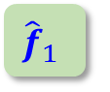

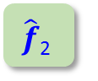
Fundamental issue: assessing the weights The prediction view
New datum
$${\hat{f}}_{1}$$
$$\hat{f}\text{2}$$
...
$$\hat{f}\text{M}$$
Base learners
Trained
prediction
Stacking
P₁
P₂
...
P_{M}
Predictions
Linear regressor
Σ
Final prediction
P_{f}
Adapted from
Notes:
Let us assume the SLR model has already been identified. If we knew the weight the SLR prediction would be easy to compute. The issue is, we do not know the weights.

Slide 4
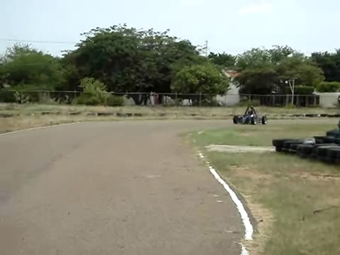
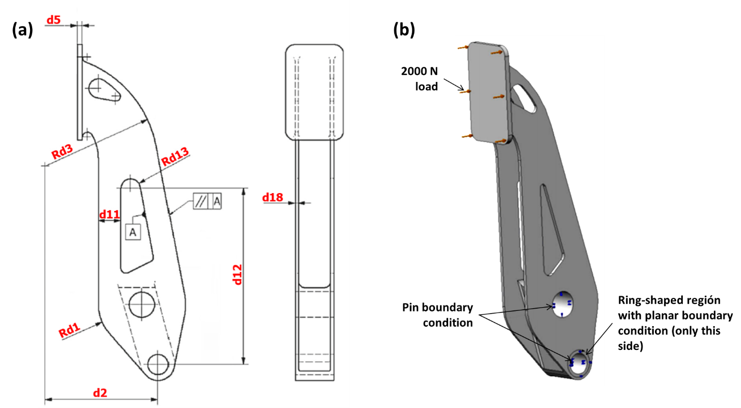
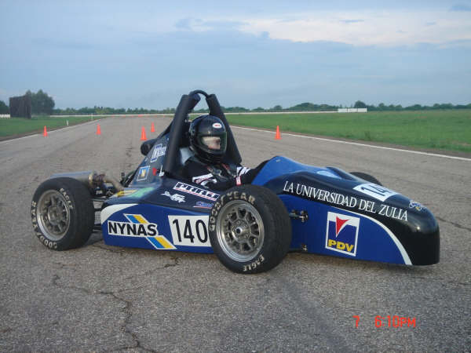
Case study – FSAE brake pedal
INPUT: 8 geometric parameters (in red) and the
Young modulus (E) of the material
OUTPUT: Maximum von Mises stress
Notes:
What is a limiting value for Aluminium? What material was used? .. Questions of interest?
1. How well does SLR performs when compared to individual surrogates? We know theoretically it should never do worse than the individual surrogates (population level) but how well it does when evaluated on a simple? 2. How well it does when compared to a committee?

Slide 5


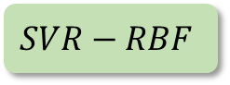

Learning view
Base learners
Linear regressor
R²
weights
R²
$$SVR−RBF$$
0.966
0.2254
0.896
$$LR$$
0.809
0.5866
Training set
Σ
$$MLP$$
0.969
0.2790
$$GP$$
0.999
-0.0990
Seed: 1024
Notes:
Shouldn’t it be testing?

Slide 6
Outline
Being bullish about ensembles
Prerequisites and desired learning outcomes
Fundamental issue: assessing the weights of the members of the ensemble
EL-SLR basic steps
Brake pedal of a Formula SAE vehicle (9D)
Replication of results
Learning outcomes revisited
Notes:
It follows the classical structure of: motivation, prerequisites and desired learning outcomes, problema formulation, method, case study, how you can replicate the results discussed in this lectura and assessing the effectiveness of the learning experience.

Slide 7
1. Being bullish about ensembles
Ensemble learning is associated with state-of-the-art performance in machine learning
Omnipresent among top performers in data science competitions
Numerous applications in science and engineering, from heart disease (e.g., time to event), reservoir management, the weather, to rocket injector performance
Stacking linear regression delivers baseline performance for alternative ensemble approaches
Notes:
Kaggle and KDD cup competions. KDD is Knowledge Discovery and Data mining.

Slide 8
Ensembles taxonomy
L3
Diversity is key! .. ensemble generalization error -> bias, variance and covariance decomposition
Ensemble generation: homogenous vs heterogenous, sequential vs parallel
Data manipulation: subsampling, random subspace, manipulating output targets
Ensemble integration: constant versus non-constant weighting functions
Heterogeneous ensembles can have homogenous ensembles as base learners
heterogenous
parallel
constant
weighting
functions
Stacking Linear Regression (SLR)
Notes:
These represent criteria by which alternative EL approaches can be identified; L3 identify alternative EL approaches

Slide 9
2. Prerequisites and desired learning outcomes
Prerequisites
Basic understanding of machine learning algorithms, i.e., linear regression, SVR, multilayer perceptron, Gaussian processes, and their hyper-parameters; holdout and cross-validation (DSCI 302, DSCI 303)
Python coding experience (COMP 140)
Desired learning outcomes
L1 - Identify basic steps of the ensemble learning approach known as Stacking Linear Regression (SLR)
L2 - Implement SLR in Python using the packages MLxtend and scikit-learn (sklearn)
L3 - Recognize alternative ensemble learning approaches
Notes:
Mention that there will be an indicationof what learning

Slide 10
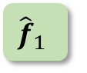

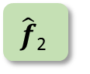
3. Fundamental issue: assessing the weights The learning problem
Training data
New datum
training
$${\hat{f}}_{1}$$
$$\hat{f}\text{2}$$
...
$$\hat{f}\text{M}$$
Base learners
Trained
prediction
Stacking
P₁
P₂
...
P_{M}
Predictions
training
Linear regressor
w₁ w₂ ... w_{M}
Σ
Final prediction
P_{f}
Notes:
The learning view. That is, given a training set, what are the weights that will minimize the squared difference between predictions and the target values.

Slide 11

Ensemble learning Stacking Linear Regression
PROBLEM OF INTEREST
FIVE STEP METHOD AND IMPLEMENTATION
FSAE BRAKE PEDAL: RESULTS AND DISCUSSION
Houston, June 17th 2019
Notes:
Thank you for coming!; my name is Nestor. I would like to share the rationale for selecting this particular topic. 1. Why Ensemble learning? It is not only a fundamental topic in statistical learning but it is a methapor for what you are building here. The ensemble is expected to outperform any individual or average model (committee). 2. Why stacked linear regression? Law of parsimony (Occam’s razor) .. Not an irrefutable principle of logic but the solutions should be as simple and as interpretable as posible. 3. Also, I wanted to reflect on a canonical example of experiential learning in engineering that unveils an important but less explored area: design and manufacturing. FSAE: 2470 students from 120 university teams every year.

Slide 12
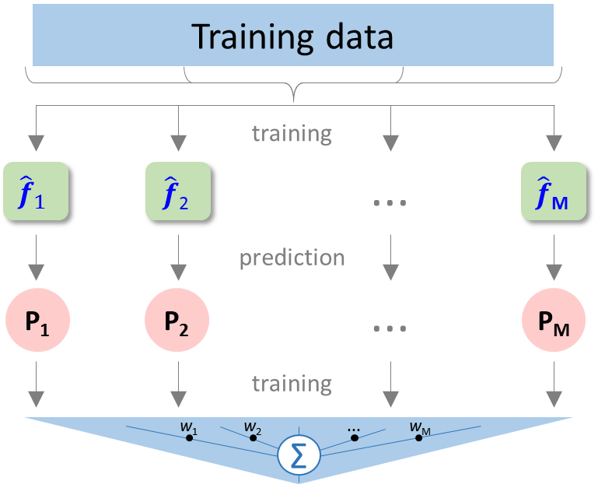
4. EL-SLR – Basic steps
L1
INPUT: Members of the ensemble with hyper-parameters grid
OUTPUT: SLR ensemble with relative contribution (weights) of the base-learners
main steps
5

Slide 13
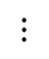
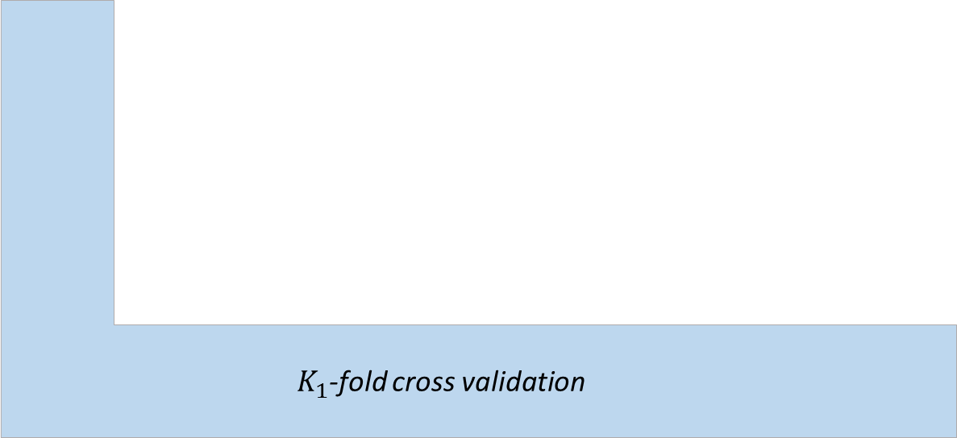

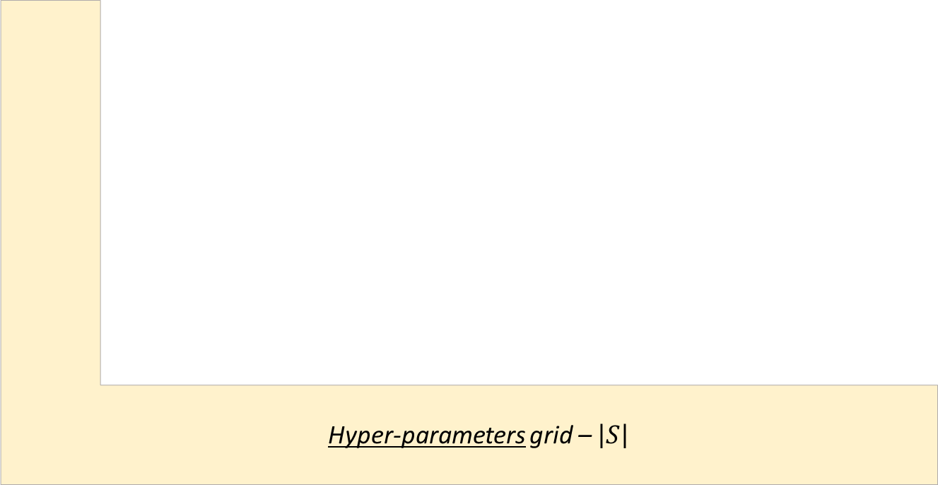


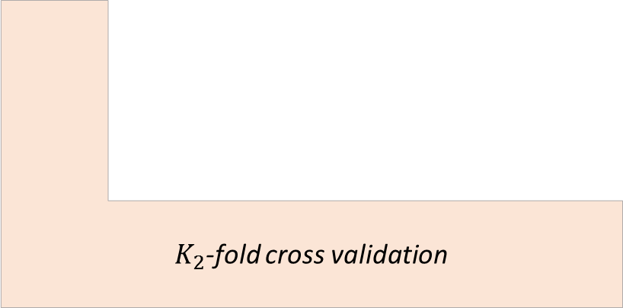
The five step summary
Bloque que oculte detalle de L-fold,
llamado SLR
Q1
Step 2
Step 3.d
Step 3.b
Step 3.a
Step 3.c
Step 4
Step 5
$K_{2}$-fold cross validation
Hyper-parameters grid – $\left|S\right|$
$K_{1}$-fold cross validation
Stacking Linear Regressor
$${\hat{f}}_{1}$$
Meta-regressor
Best set of hyper-parameters
Refit
$${\hat{f}}_{2}$$
$$⋮$$
$${\hat{f}}_{M}$$
Step 1

Slide 14


Implementation
L2
from mlxtend.regressor \ import StackingRegressor, StackingCVRegressor
Reference: Raschka S (2018) MLxtend: Providing machine learning and data science utilities and extensions to Python’s scientific computing stack J Open Source Software 3(24) doi: 10.21105/joss.00638
Available at: http://rasbt.github.io/mlxtend/
from sklearn.model_selection import GridSearchCV
Reference: Pedregosa et al. (2018) Scikit-learn: Machine Learning in Python. J Machine Learning Research 12:2825-2830
Available at: https://scikit-learn.org/stable/index.html
Notes:
Confirmar que el enlace a scikit funciona

Slide 15

Implementation
L2
# Ensemble definition
slreg = StackingCVRegressor(regressors= \
[ SVR(kernel='rbf'), \
Pipeline([('preprocessing',PolynomialFeatures(1)), ('regressor',LinearRegression())]), \
MLPRegressor(solver='lbfgs'), \
GaussianProcessRegressor(alpha=0.5, n_restarts_optimizer=4, normalize_y=False, \
kernel=Co(40.0, (1e-3, 1e2))*RBF(length_scale=0.45, length_scale_bounds=(1e-2, 1e1))) \
], meta_regressor=LinearRegression(fit_intercept=False), cv=5)
# Hyper-parameters setting (step 1)
hparams = {'svr__C': [55.0, 110.0, 220.0], \
'svr__epsilon': [0.1, 1.0, 10.0], \
'mlpregressor__hidden_layer_sizes': [4, 6, 8], \
'mlpregressor__activation': ['relu','logistic']}
Size of the $K_{2}$-fold (inner) CV
Notes:
The results are with StackingCVRegressor and the Implementation should reflect that – Update accordingly

Slide 16

Implementation
L2
# Model selection (steps 2-5)
grid = GridSearchCV(estimator=slreg, param_grid=hparams, cv=5, refit=True, \
scoring='neg_mean_squared_error')
grid.fit(Xtrain, ytrain)
best_hparams = grid.best_params_
# SLR model & weights
slr_model = grid.best_estimator_
slr_weights = slr_model.meta_regr_.coef_
# Testing error
testing_error = mean_squared_error(slr_model.predict(Xtest), ytest)
Size of the $K_{1}$-fold (outer) CV
Weights

Slide 17
Ensemble learning Stacking Linear Regression
PROBLEM OF INTEREST
FIVE STEP METHOD AND IMPLEMENTATION
FSAE BRAKE PEDAL: RESULTS AND DISCUSSION
Houston, June 17th 2019
Notes:
Thank you for coming!; my name is Nestor. I would like to share the rationale for selecting this particular topic. 1. Why Ensemble learning? It is not only a fundamental topic in statistical learning but it is a methapor for what you are building here. The ensemble is expected to outperform any individual or average model (committee). 2. Why stacked linear regression? Law of parsimony (Occam’s razor) .. Not an irrefutable principle of logic but the solutions should be as simple and as interpretable as posible. 3. Also, I wanted to reflect on a canonical example of experiential learning in engineering that unveils an important but less explored area: design and manufacturing. FSAE: 2470 students from 120 university teams every year.

Slide 18
5. Case study – FSAE brake pedal
INPUT: 8 geometric parameters (in red) and the Young modulus (E) of the material
OUTPUT: Maximum von Mises stress
Notes:
What is a limiting value for Aluminium? What material was used? .. Questions of interest?
1. How well does SLR performs when compared to individual surrogates? We know theoretically it should never do worse than the individual surrogates (population level) but how well it does when evaluated on a simple? 2. How well it does when compared to a committee?

Slide 19
5. Case study – FSAE brake pedal
Training and testing sets are complementary of size 90 and 1230
150 trials
|data_set|=1320
Feature probability distributions
Feature | Distribution | Parameters
 |  | Mean | Std.Dev.
d1 | Normal | 30.0 | 2.021
d2 |  | 75.0 | 3.350
d3 |  | 78.5 | 5.371
d5 |  | 3.0 | 0.751
d11 |  | 13.0 | 3.177
d12 |  | 97.5 | 10.570
d13 |  | 6.5 | 1.040
d18 |  | 4.0 | 1.348
E | LogNormal | 11.059 | 0.071
Maximum von Mises stress distribution
Min | Median | Mean | Std.Dev. | Max
0 | 85.065 | 97.464 | 43.870 | 294.310
Notes:
Characterize each input .. E es lognormal .. What did we do? We should have probably normalize according to a particular distribution .. Directly from the data set

Slide 20


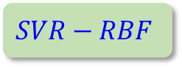

Prediction view
Base learners
Linear regressor
MAE
MSE
weights
MAE
MSE
$$SVR−RBF$$
11.1
439.6
0.2254
9.9
326.5
$$LR$$
14.8
480.8
0.5866
Testing set
Σ
$$MLP$$
12.2
481.8
0.2790
$$GP$$
15.0
838.1
-0.0990
Seed: 1024
MAE: Median absolute error
Notes:
Shouldn’t it be testing?

Slide 21
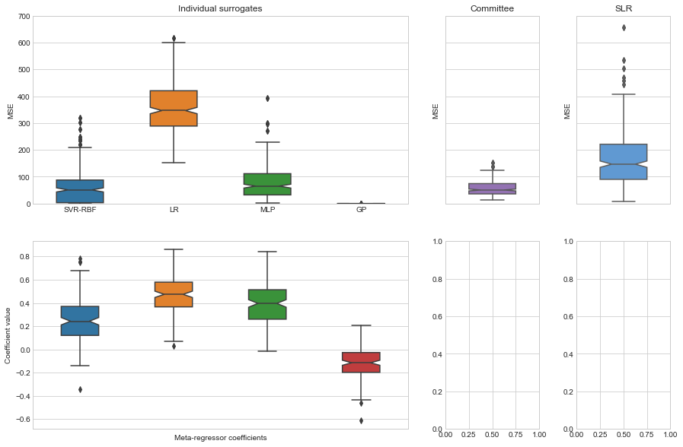
Performance – Training data
Stacking Linear Regressor
Base learners performance
Mean squared error
SVR-RBF LR MLP GP
Computational time (single trial, in seconds) | 0.065 | 0.002 | 0.972 | 0.07 |  | 52.4
Windows 10 64 bits PC using a i7-8550U processor at 1.80 GHz with 16 GB RAM
Notes:
Integrate Training and Testing – (1) Base learners performance on training on the left and testing on the right (with weight distribution on the bottom; (2) Committee prediction and stacking
linear regressor; (3) Tables with median comparison: then the distributions of MSE with Table with median comparison for 180 points

Slide 22
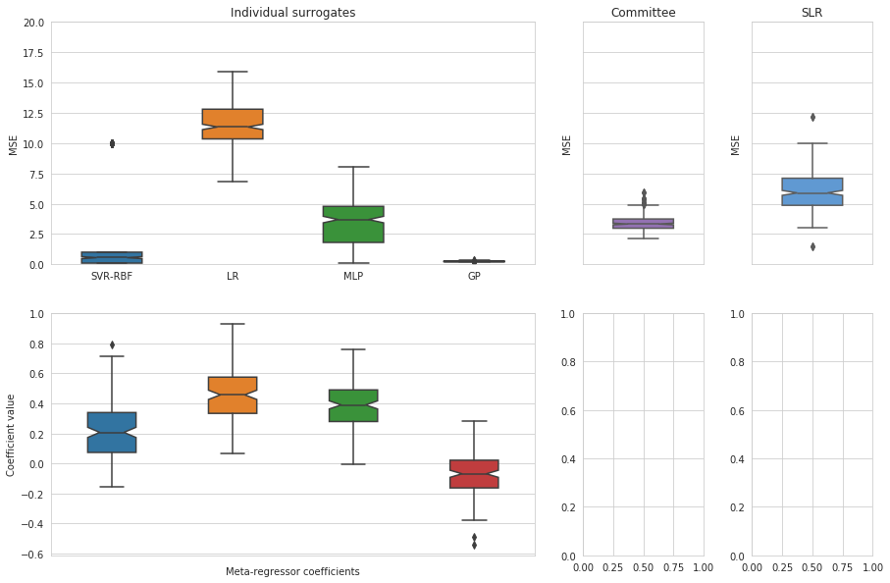
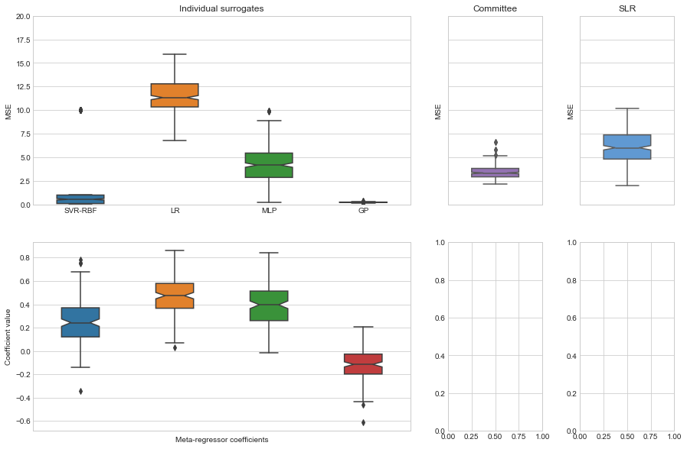
Performance – Training data
Stacking Linear Regressor
Base learners performance
Median absolute error
SVR-RBF LR MLP GP
Notes:
Integrate Training and Testing – (1) Base learners performance on training on the left and testing on the right (with weight distribution on the bottom; (2) Committee prediction and stacking
linear regressor; (3) Tables with median comparison: then the distributions of MSE with Table with median comparison for 180 points

Slide 23
Performance – Training data
SLR meta-regressor coefficients
Weights
SVR-RBF LR MLP GP
Notes:
Integrate Training and Testing – (1) Base learners performance on training on the left and testing on the right (with weight distribution on the bottom; (2) Committee prediction and stacking
linear regressor; (3) Tables with median comparison: then the distributions of MSE with Table with median comparison for 180 points

Slide 24
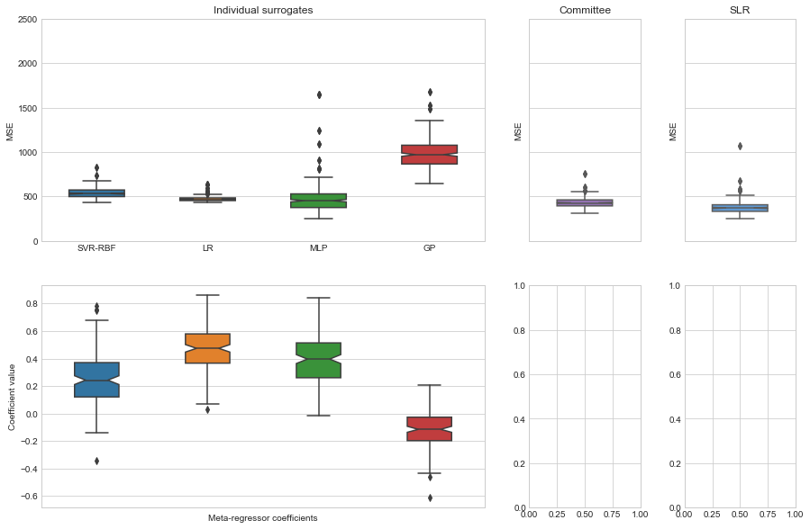
Performance – Testing data
Stacking Linear Regressor
Base learners performance
Committee
Mean squared error
SVR-RBF LR MLP GP
Notes:
What are characteristic values of the Maximum von Mises Stress; are the errors reasonable?

Slide 25
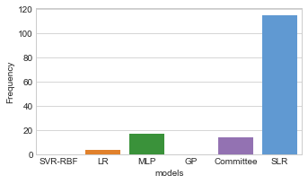
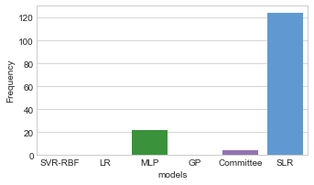
Winner
Ensemble | Median (MSE)
SLR | 370.8
Committee | 426.8
13%
90 samples
Frequency
150 trials
SVR-RBF LR MLP GP Committee SLR
180 samples
Ensemble | Median (MSE)
SLR | 278.9
Committee | 339.4
18%
Frequency
SVR-RBF LR MLP GP Committee SLR
Winner: lowest MSE
Notes:
What are characteristic values of the Maximum von Mises Stress; are the errors reasonable?

Slide 26
Summary
Stacking linear regression is one of the simplest yet effective EL approaches; can be used to benchmark more sophisticated schemes
SLR can be implemented using nested cross-validation and the regression normal equation; the StackingCVRegressor class is available in the MLxtend package
A natural extension: fit the predictions to non-linear regressors (non-constant weights)
Alternative EL approaches consider homogenous base learners, sequential generation of the members of the ensemble, and data manipulation, such as random subspace and subsampling

Slide 27
6. Revisiting desired learning outcomes

Slide 28

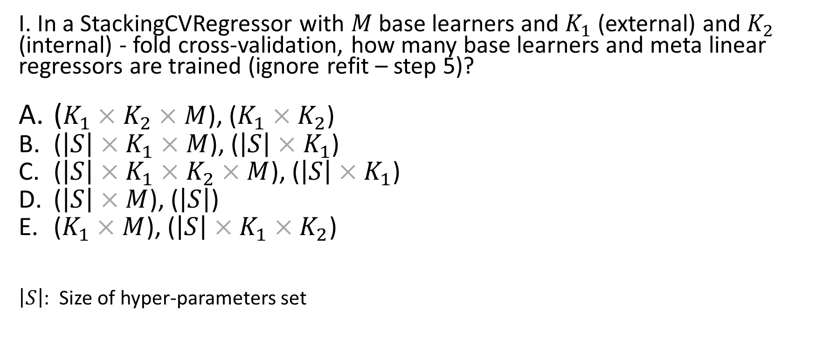






7.1 Q&A sample question
Q1
I. In a StackingCVRegressor with $M$ base learners and $K_{1}$ (external) and $K_{2}$ (internal) - fold cross-validation, how many base learners and meta linear regressors are trained (ignore refit – step 5)?
($K_{1}×K_{2}×M$), ($K_{1}×K_{2}$)
($\left|S\right|×K_{1}×M$), ($\left|S\right|×K_{1}$)
($\left|S\right|×K_{1}×K_{2}×M$), ($\left|S\right|×K_{1}$)
($\left|S\right|×M$), ($\left|S\right|$)
($K_{1}×M$), ($\left|S\right|×K_{1}×K_{2}$)
$\left|S\right|$: Size of hyper-parameters set
$K_{2}$-fold cross validation
Hyper-parameters grid – $\left|S\right|$
$K_{1}$-fold cross validation
$${\hat{f}}_{1}$$
Meta-regressor
Best set of hyper-parameters
$${\hat{f}}_{2}$$
$$⋮$$
$${\hat{f}}_{M}$$
Notes:
Animate the true answer
True Answer:
Number of base learners trained: |S| x K x L x M
Number of meta-regressors trained: |S| x K

Slide 29
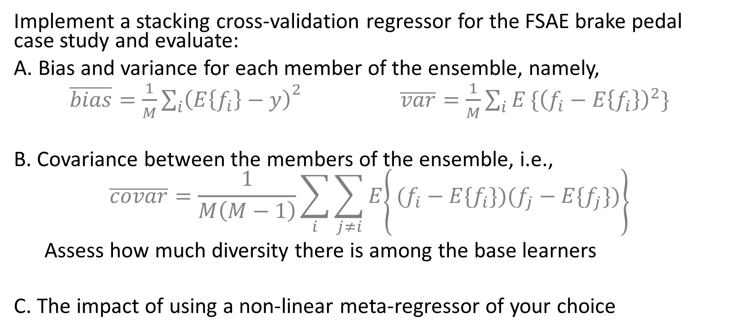
7.2 Sample assigment
Implement a stacking cross-validation regressor for the FSAE brake pedal case study and evaluate:
A. Bias and variance for each member of the ensemble, namely,
$\overline{bias}=\frac{1}{M}{\sum_{i}{\left(E\left\{f_{i}\right\}−y\right)}}^{2}$ $\overline{var}=\frac{1}{M}\sum_{i}{E}\{{\left(f_{i}−E\left\{f_{i}\right\}\right)}^{2}\}$
B. Covariance between the members of the ensemble, i.e.,
$$\left.\overline{covar}=\frac{1}{M\left(M−1\right)}\sum_{i}{\left.\sum_{j≠i}{E}\right\{}(f_{i}−E\{f_{i}\})(f_{j}−E\{f_{j}\})\right\}$$
Assess how much diversity there is among the base learners
C. The impact of using a non-linear meta-regressor of your choice
Notes:
Rewrite the equation as cov fi,fj (hat) =

Slide 30



7. Replication of results
theRICEvisit
Lecture
Notebooks and data
Colaboratory (cloud)
Jupyter (local)
Refs
Jupyter and Colaboratory notebooks
Software dependencies
Classes of particular interest
Explicit declaration of random seeds
GitHub & DOI (Zenodo)
Data and code (Jupyter and Colaboratory notebooks) needed to replicate the results for the FSAE brake pedal case study can be found at https://github.com/nqueipo/theRICEvisit
References: Haftka R, Zhou M, and Queipo N (2019) Replication of results (in press), Structural and Multidisciplinary Journal Editorial, Springer, ISSN1615-147X
Google Colaboratory
Support material

Slide 31
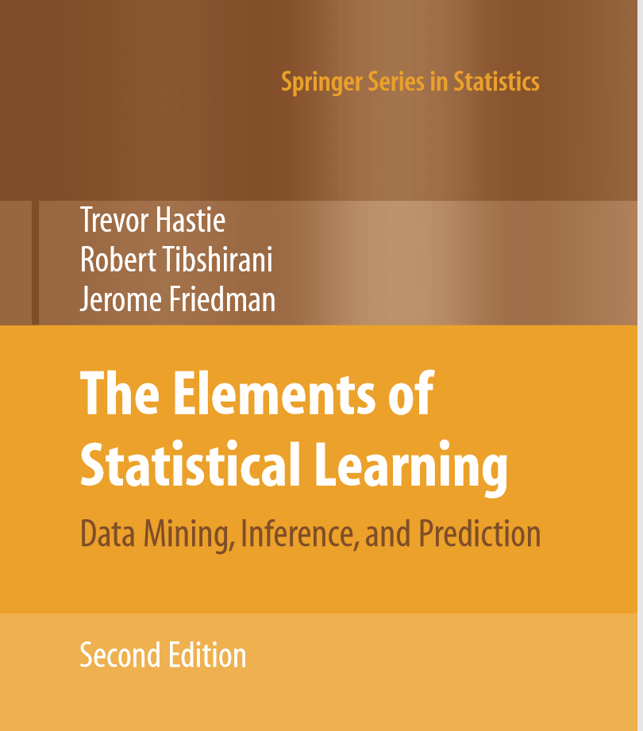
References
Section 8.8 Model Averaging and Stacking,
pag. 288-290
Available at: https://web.stanford.edu/~hastie/ElemStatLearn/
Notes:
Incorporate this reference: Raschka S (2018) “MLxtend: Providing machine learning and data science utilities and extensions to Python’s scientific computing stack” J Open Source Software. 3(24). doi: 10.21105/joss.00638
Available at: http://rasbt.github.io/mlxtend/; showing in the left how the place to download the software looks like

Slide 32
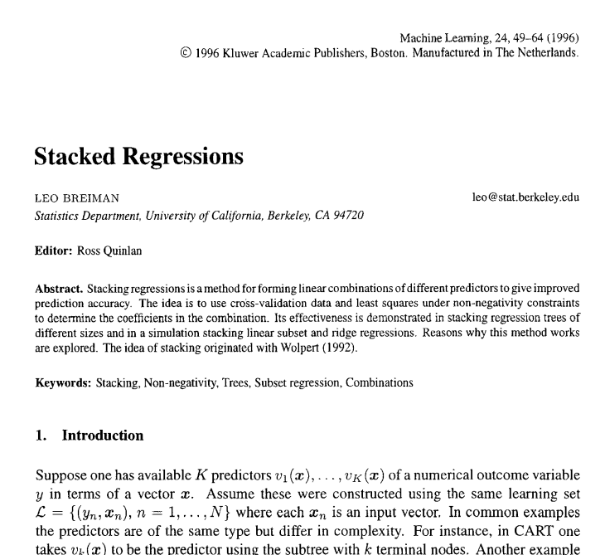
References
L Breiman. Stacked regressions. Machine Learning, 24, 49-64 (1996)
Notes:
Incorporate this reference: Raschka S (2018) “MLxtend: Providing machine learning and data science utilities and extensions to Python’s scientific computing stack” J Open Source Software. 3(24). doi: 10.21105/joss.00638
Available at: http://rasbt.github.io/mlxtend/; showing in the left how the place to download the software looks like

Slide 33
References
T Goel, RT Haftka, W Shyy, NV Queipo. Ensemble of surrogates. Structural and Multidisciplinary Optimization 33 (3) 199-216, 2007
E Sanchez, S Pintos, NV Queipo. Toward an optimal ensemble of kernel-based approximations with engineering applications. Structural and Multidisciplinary Optimization 36 (3) 247-261, 2008
NV Queipo, E Nava. A gradient boosting approach with diversity promoting measures for the ensemble of surrogates in engineering. Structural and Multidisciplinary Optimization, 2019 (Accepted)
J Romero, N Queipo. Reliability-based and deterministic design optimization of a FSAE brake pedal: a risk allocation analysis. Structural and Multidisciplinary Optimization 56 (3), 681-695, 2017
Notes:
Incorporate this reference: Raschka S (2018) “MLxtend: Providing machine learning and data science utilities and extensions to Python’s scientific computing stack” J Open Source Software. 3(24). doi: 10.21105/joss.00638
Available at: http://rasbt.github.io/mlxtend/; showing in the left how the place to download the software looks like

Slide 34
Support material
Five steps algorithm for SLR building
Sample of common base learners
Jupyter notebook
Notes:
Incorporate this reference: Raschka S (2018) “MLxtend: Providing machine learning and data science utilities and extensions to Python’s scientific computing stack” J Open Source Software. 3(24). doi: 10.21105/joss.00638
Available at: http://rasbt.github.io/mlxtend/; showing in the left how the place to download the software looks like

Slide 35

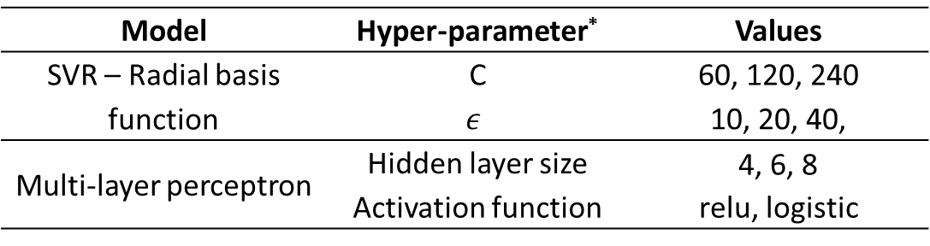
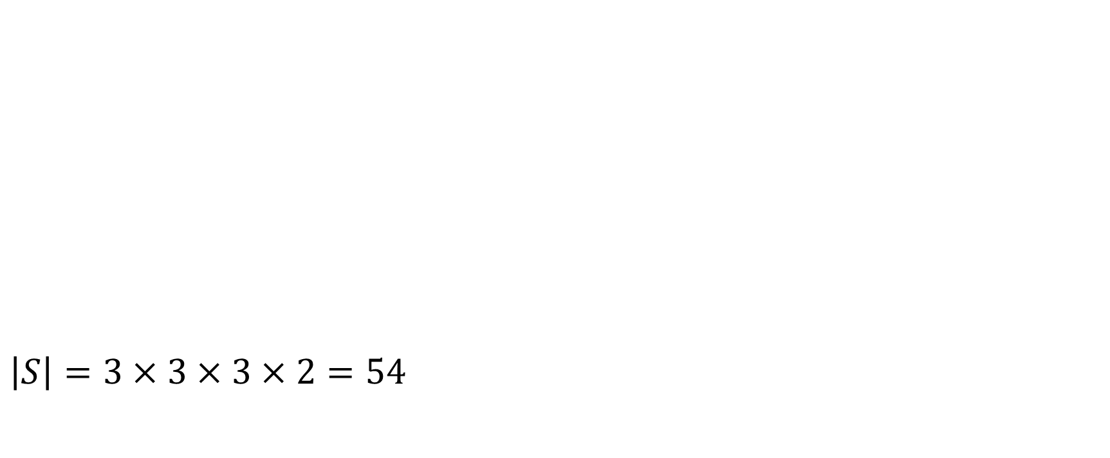
Step 1: Specify the set $S$ of possible hyper-parameters (grid) considering all the members of the ensemble
L1
1/5
$\left|S\right|=3×3×3×2=54$
Base learners hyper-parameters grid – FSAE brake pedal case study
Model | Hyper-parameter* | Values
SVR – Radial basis function | C | 60, 120, 240
 | $$ε$$ | 10, 20, 40,
Multi-layer perceptron | Hidden layer size | 4, 6, 8
 | Activation function | relu, logistic
* The C and $ε$ values under consideration are 0.5, 1.0 and 2.0 times the reference value calculated as proposed by Cherkassky and Ma (2004)
Notes:
This is the place for the hyper-parameters. The search space will be given by the size of the set S.

Slide 36


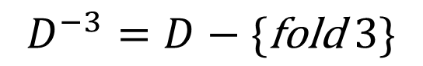
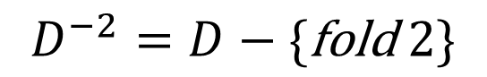
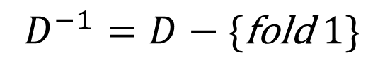

Step 2: Split dataset $D$ into $K_{1}$ folds, with training sets $D^{−i}$ corresponding to $D$ – { fold $i$}; $i=1,2,…,K_{1}$
Step 1: Specify the set $S$ of possible hyper-parameters (grid) considering all the members of the ensemble
L1
2/5
5-folds 1 2 3 4 5
$$D^{−2}=D−\{\text{fold} 2\}$$
$$D^{−3}=D−\{\text{fold} 3\}$$
$$D^{−1}=D−\{\text{fold} 1\}$$
$$D$$
Train
Test
Notes:
Rehacer figura.

Slide 37
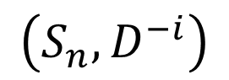
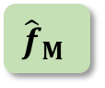
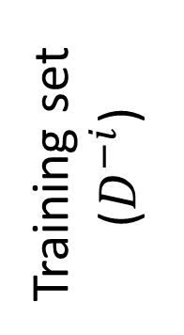
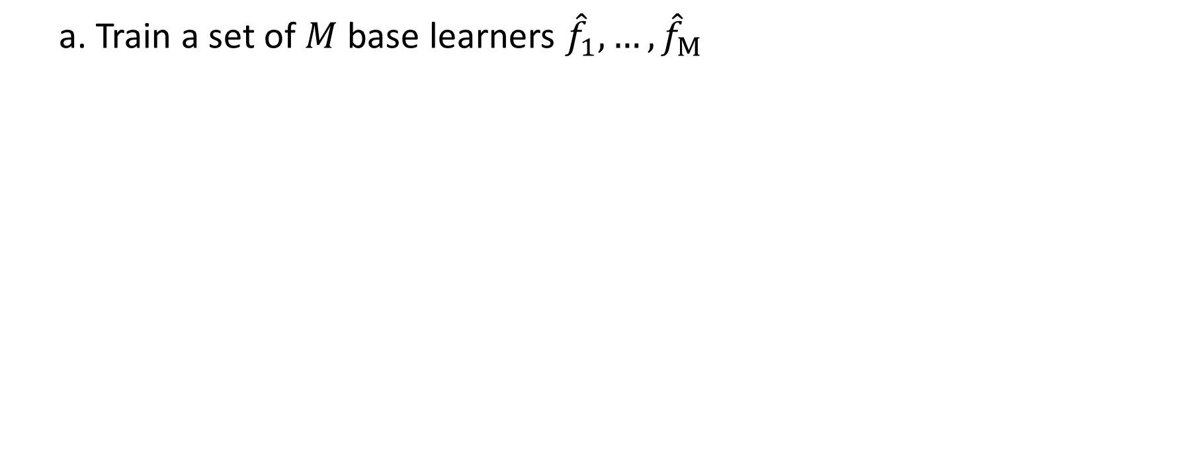
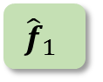

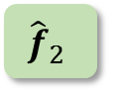
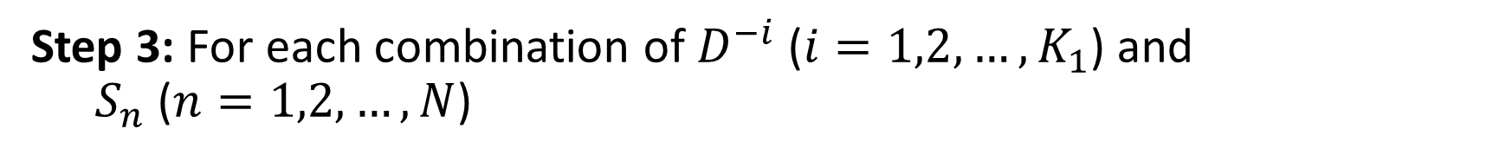
Step 3: For each combination of $D^{−i}$ ($i=1,2,…,K_{1}$) and $S_{n}$ ($n=1,2,…,N$)
Step 2: Split dataset $D$ into $K_{1}$ folds, with training sets $D^{−i}$ corresponding to $D$ – { fold $i$}; $i=1,2,…,K_{1}$
L1
3/5
a. Train a set of $M$ base learners ${\hat{f}}_{1},…,{\hat{f}}_{M}$
Base learners
$${\hat{f}}_{1}$$
Training set ($D^{−i}$)
$${\hat{f}}_{2}$$
...
$${\hat{f}}_{M}$$
Untrained
$$\left(S_{n}, D^{−i}\right)$$
Trained
Notes:
Upper case k

Slide 38

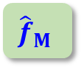
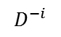
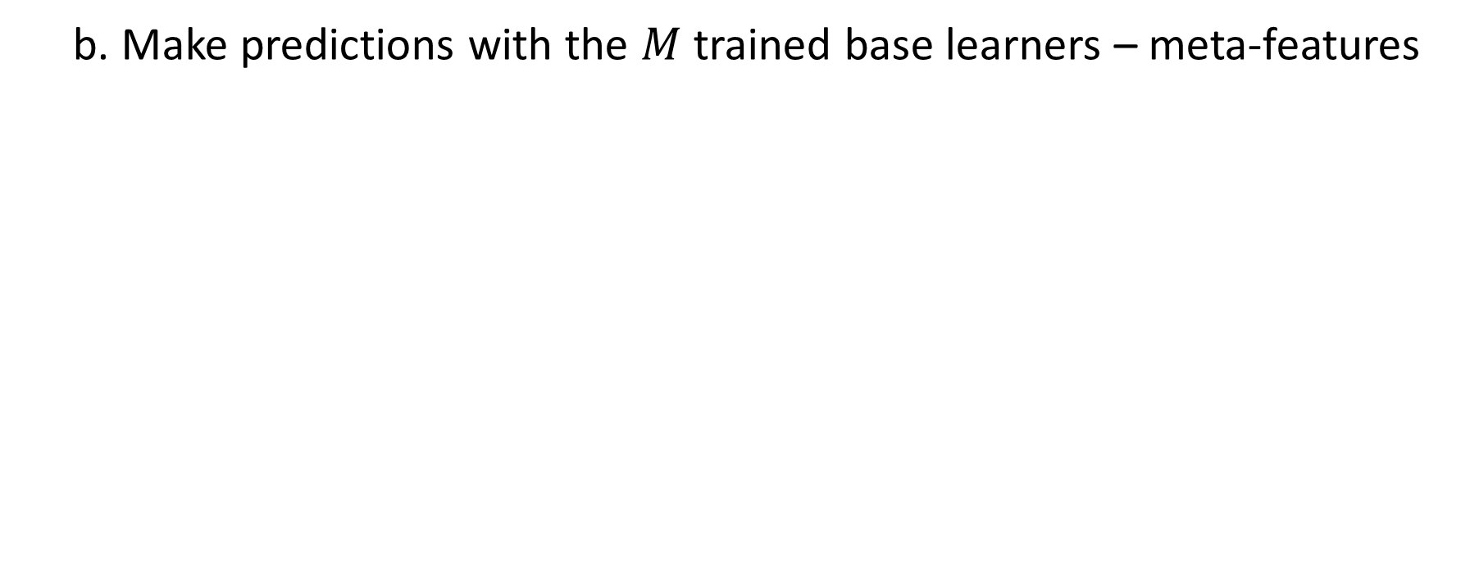
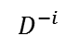
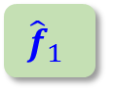
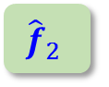
Step 3: For each combination of $D^{−i}$ ($i=1,2,…,K_{1}$) and $S_{n}$ ($n=1,2,…,N$)
Step 2: Split dataset $D$ into $K_{1}$ folds, with training sets $D^{−i}$ corresponding to $D$ – { fold $i$}; $i=1,2,…,K_{1}$
L1
b. Make predictions with the $M$ trained base learners – meta-features
Base learners
Predictions
$$D^{−i}$$
$${\hat{f}}_{1}$$
P₁
$$D^{−i}$$
Training set ($D^{−i}$)
$${\hat{f}}_{2}$$
P₂
...
...
$$D^{−i}$$
$${\hat{f}}_{M}$$
P_{M}
$$\left(S_{n}, D^{−i}\right)$$
$K_{2}$-fold CV should be used – out of fold predictions

Slide 39

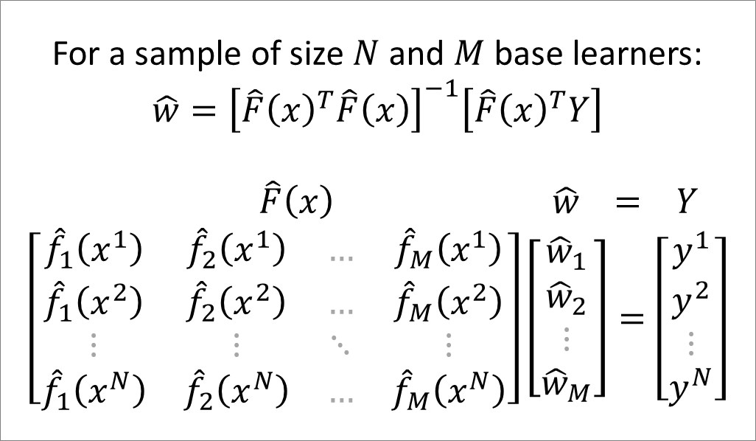
Step 3: For each combination of $D^{−i}$ ($i=1,2,…,K_{1}$) and $S_{n}$ ($n=1,2,…,N$)
Step 2: Split dataset $D$ into $K_{1}$ folds, with training sets $D^{−i}$ corresponding to $D$ – { fold $i$}; $i=1,2,…,K_{1}$
L1
c. Train (identify the weights) a stacking linear regressor using the meta features from step (b) and the corresponding target values
Base learners
Predictions
Linear regressor
For a sample of size $N$ and $M$ base learners:
$$\hat{w}={\left[\hat{F}{\left(x\right)}^{T}\hat{F}\left(x\right)\right]}^{−1}\left[\hat{F}{\left(x\right)}^{T}Y\right]$$
$\hat{F}\left(x\right) \hat{w} = Y$
$$\left[\begin{matrix}{\hat{f}}_{1}\left(x^{1}\right) & {\hat{f}}_{2}\left(x^{1}\right) & … & {\hat{f}}_{M}\left(x^{1}\right) \\ {\hat{f}}_{1}\left(x^{2}\right) & {\hat{f}}_{2}\left(x^{2}\right) & … & {\hat{f}}_{M}\left(x^{2}\right) \\ ⋮ & ⋮ & ⋱ & ⋮ \\ {\hat{f}}_{1}\left(x^{N}\right) & {\hat{f}}_{2}\left(x^{N}\right) & … & {\hat{f}}_{M}\left(x^{N}\right)\end{matrix}\right]\left[\begin{matrix}{\hat{w}}_{1} \\ {\hat{w}}_{2} \\ ⋮ \\ {\hat{w}}_{M}\end{matrix}\right]=\left[\begin{matrix}y^{1} \\ y^{2} \\ ⋮ \\ y^{N}\end{matrix}\right]$$
$$D^{−i}$$
$${\hat{f}}_{1}$$
P₁
$$D^{−i}$$
Training set ($D^{−i}$)
$${\hat{f}}_{2}$$
P₂
Σ
...
...
$$D^{−i}$$
$${\hat{f}}_{M}$$
P_{M}
Untrained
$$\left(S_{n}, D^{−i}\right)$$
Trained
Notes:
MLXtend allows to include the original input features (Xs) in the meta-regressor REF: http://rasbt.github.io/mlxtend/api_subpackages/mlxtend.regressor/#stackingcvregressor
use_features_in_secondary : bool (default: False)
If True, the meta-regressor will be trained both on the predictions of the original regressors and the original dataset. If False, the meta-regressor will be trained only on the predictions of the original regressors.

Slide 40
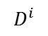
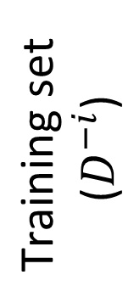

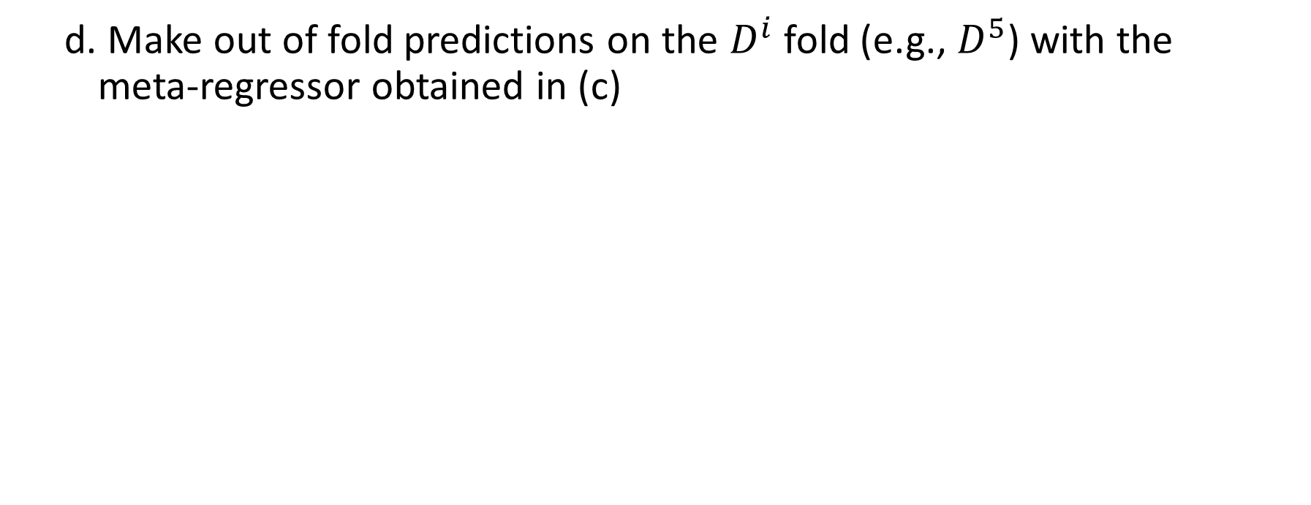
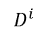
Step 3: For each combination of $D^{−i}$ ($i=1,2,…,K_{1}$) and $S_{n}$ ($n=1,2,…,N$)
Step 2: Split dataset $D$ into $K_{1}$ folds, with training sets $D^{−i}$ corresponding to $D$ – { fold $i$}; $i=1,2,…,K_{1}$
L1
d. Make out of fold predictions on the $D^{i}$ fold (e.g., $D^{5}$) with the meta-regressor obtained in (c)
Base learners
Predictions
Linear regressor
$$D^{i}$$
$$D^{−i}$$
$${\hat{f}}_{1}$$
P₁
$$D^{i}$$
$$D^{−i}$$
$$\text{Training} \text{set} \\ \text{(}D^{−i}\text{)}$$
$${\hat{f}}_{2}$$
P₂
$$D^{i}$$
Fold $i$ ($D^{i}$)
P_{f}
Out of fold prediction
Σ
...
...
$$D^{i}$$
$$D^{−i}$$
$${\hat{f}}_{M}$$
P_{M}
$$\left(S_{n}, D^{−i}\right)$$
Trained

Slide 41
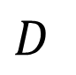
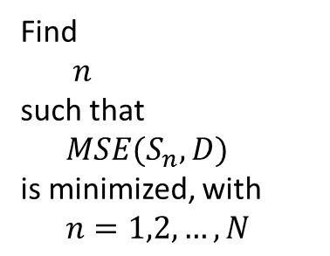
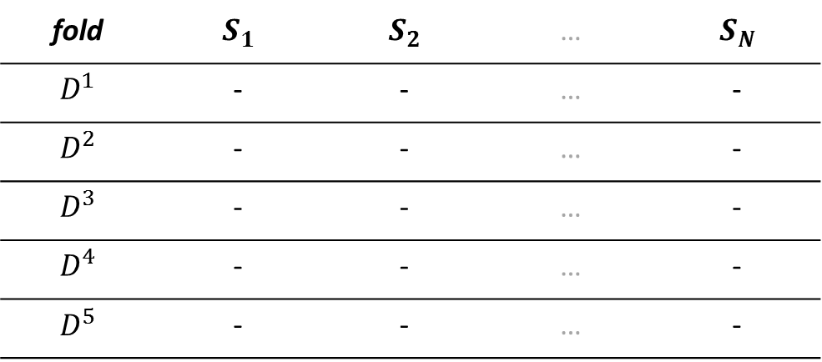


Step 4: Select the set of hyper-parameters $S_{n}$ associated with the lowest cross-validation error computed on $D$
Step 3: For each combination of $D^{−i}$ ($i=1,2,…,K_{1}$) and $S_{n}$ ($n=1,2,…,N$)
L1
4/5
5-folds 1 2 3 4 5
fold | $$S_{1}$$ | $$S_{2}$$ | … | $$S_{N}$$
$$D^{1}$$ | - | - | … | -
$$D^{2}$$ | - | - | … | -
$$D^{3}$$ | - | - | … | -
$$D^{4}$$ | - | - | … | -
$$D^{5}$$ | - | - | … | -
Find $n$
such that $MSE(S_{n}, D)$
is minimized, with $n=1,2,…,N$
$$D$$
$$\text{Complete} \text{dataset}\text{ (}D\text{)}$$ | $$MSE(S1,D)$$ | $$MSE(S2,D)$$ | … | $$MSE(S_{N},D)$$
Train
Test

Slide 42





Step 5: The stacking linear regressor is obtained using $K_{2}$-fold CV on the complete dataset $D$ and the best set of hyper-parameters (step 4)
Step 4: Select the set of hyper-parameters $S_{n}$ associated with the lowest cross-validation error computed on $D$
L1
5/5
Base learners
Predictions
Linear regressor
$$D^{}$$
$${\hat{f}}_{1}$$
P₁
$$D^{}$$
$${\hat{f}}_{2}$$
P₂
$$D$$
Σ
...
...
$$D^{}$$
$${\hat{f}}_{M}$$
P_{M}
Trained
42
Notes:
Include a note that says, realistically, we do cross-validation on D-i

Slide 43


Base learners - parameters
Base learner | Output | Hyper-parameters | Learning parameters
Multilayer perceptron | $$\hat{y}\left(x\right)=act\left(W×act1\left(V×x\right)\right)$$ $act\left(∙\right):$ output layer transfer function $act1\left(∙\right):$hidden layer transfer function augmented w/unit column vector $V,W:$ Weight matrices between input-hidden and hidden-output layers, respectively | Transfer function Number of neurons in hidden layer | Weight and bias values ($V,W$)
Gaussian Process | $$\hat{y}(x)=x^{T}β+ε(x)$$ $$ε\left(x\right)={w(x)}^{T}C^{−1}Y$$ $w:Cov\left(X,x\right)$ $C:Cov\left(X,X\right)+I∙α$ $α:$ expected target noise level For a RBF covariance function: $Cov\left(x_{i},x_{j}\right)=σ^{2}∙exp\left({−\frac{1}{2ℓ^{2}}\left\|x_{i}−x_{j}\right\|}^{2}\right)$ | Target noise level ($α$) Number of optimizer (L-BFGS-B) restarts | Regression weights ($β$) Length parameter ($ℓ$) Target variance ($σ^{2}$)
Support Vector Regression | $$\hat{y}\left(x\right)=α∙K\left(X,x\right)+b$$ $α:$ Support vector weights $b:$ Bias $K(∙):$ Kernel function The RBF kernel: $K\left(X,x\right)=exp\left({−γ∙\left\|X−x\right\|}^{2}\right)$ | $ε$-insensitive loss function: No penalty tube width ($ε$) Penalization term ($C$) RBF kernel param ($γ$) | Support vector weights ($α$) Bias ($b$)
V
W
Multilayer perceptron
Gaussian process
Support Vector Regression
…
…
Σ
∊
V
W
σ²
σ²
…
C
…
Σ
0.4ℓ
0.4ℓ
∊
C
Notes:
Distinguish between learning and hyperparameters. Limited-memory BFGS (L-BFGS or LM-BFGS) is an optimization algorithm in the family of quasi-Newton methods that approximates the Broyden–Fletcher–Goldfarb–Shanno (BFGS) algorithm using a limited amount of computer memory. The L-BFGS-B algorithm extends L-BFGS to handle simple box constraints (aka bound constraints) on variables; that is, constraints of the form l_{i} ≤ x_{i} ≤ u_{i} where l_{i} and u_{i} are per-variable constant lower and upper bounds, respectively (for each x_{i}, either or both bounds may be omitted).^{[6][7]}

Slide 44
Jupyter notebook
Software dependencies
FSAE case study data load
Model training & evaluation
Main program
Visualization

Slide 45


Slide 46


Slide 47


Slide 48


Slide 49


Slide 50


Slide 51


Slide 52


Slide 53


Slide 54


Slide 56


3. Fundamental issue: assessing the weights The learning problem
Find $w = w_{1}, w_{2}, …, w_{M}$
$$\hat{w}=\underset{w}{argmin}{{\left[Y−\sum_{m=1}^{M}{w_{m}{\hat{f}}_{m}\left(x\right)}\right]}^{2}}$$
The solution is the linear regression of $Y$ on
$$\hat{F}\left(x\right)≡[{\hat{f}}_{1}\left(x\right),{\hat{f}}_{2}\left(x\right),…,{\hat{f}}_{M}\left(x\right)]$$
$$\hat{w}={\left[\hat{F}{\left(x\right)}^{T}\hat{F}\left(x\right)\right]}^{−1}\left[\hat{F}{\left(x\right)}^{T}Y\right]$$
$\hat{F}\left(x\right) \hat{w} = Y$
$$\left[\begin{matrix}{\hat{f}}_{1}\left(x^{1}\right) & {\hat{f}}_{2}\left(x^{1}\right) & … & {\hat{f}}_{M}\left(x^{1}\right) \\ {\hat{f}}_{1}\left(x^{2}\right) & {\hat{f}}_{2}\left(x^{2}\right) & … & {\hat{f}}_{M}\left(x^{2}\right) \\ ⋮ & ⋮ & ⋱ & ⋮ \\ {\hat{f}}_{1}\left(x^{N}\right) & {\hat{f}}_{2}\left(x^{N}\right) & … & {\hat{f}}_{M}\left(x^{N}\right)\end{matrix}\right]\left[\begin{matrix}{\hat{w}}_{1} \\ {\hat{w}}_{2} \\ ⋮ \\ {\hat{w}}_{M}\end{matrix}\right]=\left[\begin{matrix}y^{1} \\ y^{2} \\ ⋮ \\ y^{N}\end{matrix}\right]$$
Notes:
More specifically, we want to find the weights that minimize the difference between the target values and the weighted sum of the base learners predictions. MISSING THE SQUARE IN THE LOSS FU

Slide 57

3. Fundamental issue: assessing the weights The learning problem
$$E_{Ρ}{\left[Y−\sum_{m=1}^{M}{w_{m}{\hat{f}}_{m}\left(x\right)}\right]}^{2}≤E_{Ρ}{\left[Y−{\hat{f}}_{m}\left(x\right)\right]}^{2} ∀m$$
So at the population level combining models never would make things worse
From: The Elements of Statistical Learning, pages 288-290 (Hastie et al. 2009)

